Slide 1
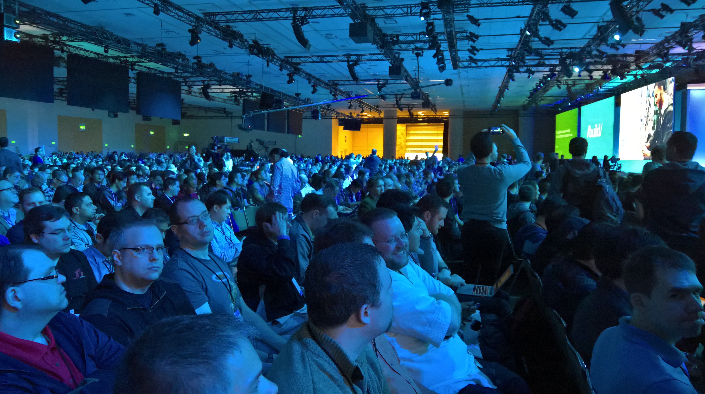
Tearing the down
ing
Jim Wooley
www.ThinqLinq.com
Twitter: @JimWooley

Slide 2
Top 10 tech
Helping the blind to see
Jim
Jeremy
Xamarin
Conversations as a Platform (Bots)
Bash (via Ubuntu) in Windows Anniversary
.Net core
Visual Studio 15
C# 7
Centennial - Win 32 with Store capabilities
Azure Functions
Xbox dev mode
Hololens – shipping dev kits
Xamarin Free
Bash (Ubuntu) on Windows
Kestrel scaled to 1.6 million requests per second
EF Core Improvements
O365 Extensions with HTML and JavaScript
Azure Functions
DocumentDB with MongoDB driver
Cognitive APIs
Bot Framework
Microsoft Graph API

Slide 3
Conversations as a Platform
https://dev.botframework.com
https://www.microsoft.com/cognitive-services
Semantic dictionary for syntax parsing with alternative suggestions via bing
Luis
http://www.skype.com/en/developer/

Slide 4
Xamarin
Free for ALL
Mono open source with MIT license
iOs remote emulator from VS on a PC
Workbooks for learning/documentation
Inspector for debugging UI

Slide 5
LUIS

Slide 6
Project Centennial
Package Win32/winform/wpf apps and publish appx to store
Install and launch by double click appx
Feature detection to add Win10 capabilities

Slide 7
Visual studio 15
Different from 2015 Update 2
Lightweight installer < 180 seconds, no registry
Colorization and syntax highlighting for Go, Ruby
Plugin support for platforms (C++, Python, etc)
Code Completion – How do I
Add using and download from Nuget
Find all references/go to definition pulls from github
Enforced Code Style
XAML Edit and Continue
https://www.visualstudio.com/news/vs15-preview-vs

Slide 8
C# 7
Binary literals
Digit separators
Tuples
Local functions
Pattern matching
C#7 proposals - https://github.com/dotnet/roslyn/issues/2136

Slide 9
Linux
https://blogs.windows.com/buildingapps/2016/03/30/run-bash-on-ubuntu-on-windows/
Bash on Ubuntu on Windows - https://channel9.msdn.com/Events/Build/2016/P488
www.Redhatloves.net

Slide 10
.Net core
.Net all the things
Windows, Linux, IOT, Hololens, Docker
Perf improvements
ASP - https://github.com/aspnet/benchmarks compare to http://www.techempower.com/benchmarks/
http://www.dualshockers.com/2016/03/31/age-of-ascent-can-handle-50000-players-thanks-to-microsofts-cloud-see-it-in-action/

Slide 11
Misc
Videos and slides - https://channel9.msdn.com/Events/Build/2016
Labs - https://github.com/microsoft-build-2016

Slide 12
Tearing the down
ing
Jim Wooley
www.ThinqLinq.com
Twitter: @JimWooley

