Slide 1
Windows 8 as an ApP Integration Hub
Charms, Pickers, Contracts
@JimWooley
http://www.ThinqLinq.com

Slide 2






Web Based Application Integration

Slide 3


Win8 Application Integration

Slide 4
Windows 8 Integration Options
Contracts
Search
Share
Settings
Extension
Protocol
Pickers
File
Contact
Charms

Slide 5

File Extensions (.mp3, .jpg, .foo)
Protocol (mailto)
Schema.org
Notes:
F:\Projects\Windows 8 Release Preview Metro style app samples - C#, VB.NET, C++, JavaScript\Association launching sample

Slide 6

Pickers
FileOpenPicker
FileSavePicker
FolderPicker
ContactPicker
CredentialPicker

Slide 7
FileOpenPicker
var openPicker = new Windows.Storage.Pickers.FileOpenPicker();
openPicker.fileTypeFilter.replaceAll([".png",
".jpg",
".jpeg"]);
openPicker.pickSingleFileAsync().then(function (file) {
if (file) {
// Do something with the selected file
} else {
// The picker was dismissed with no selected file
}
});
Notes:
Demo FileOpenPicker and then add a FileOpenContract

Slide 8



Charms

Slide 9
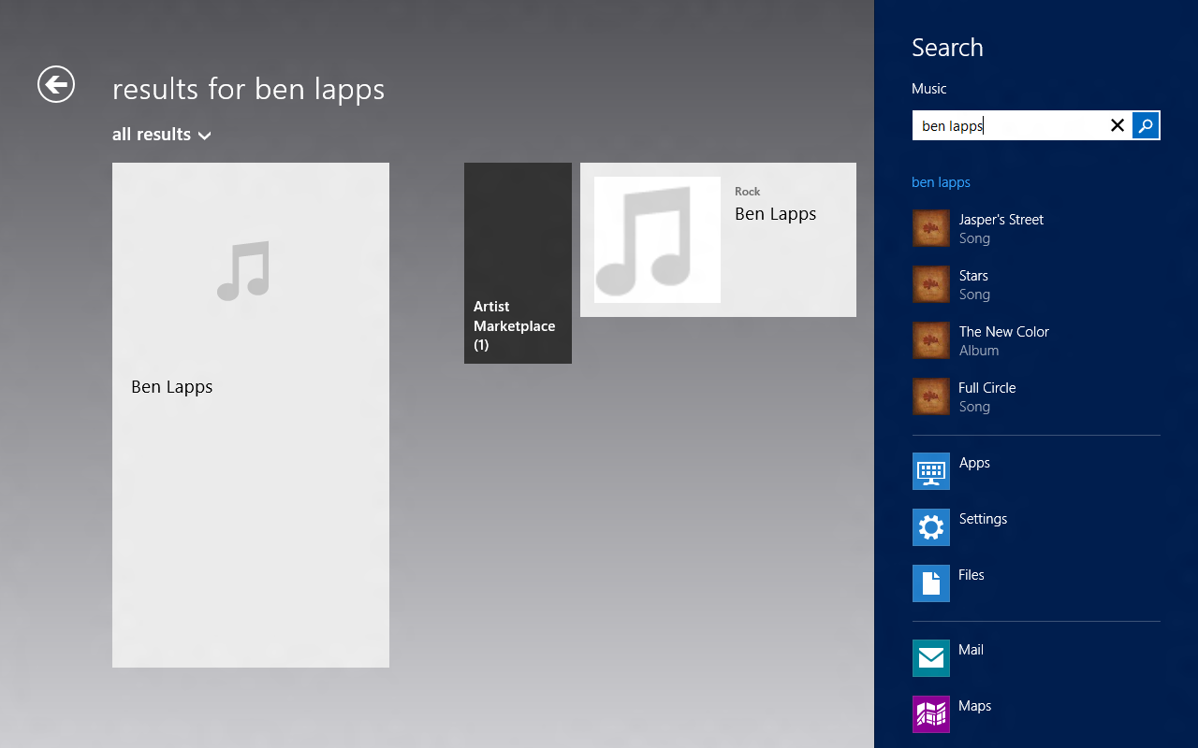
Search Contract
Share provides a lightweight, in context, easy experience for accomplishing
Share provides a lightweight, in context, easy experience for accomplishing

Slide 10
Search Activation
protected override void OnSearchActivated(
SearchActivatedEventArgs args)
{
SearchResultsPage1.Activate(
args.QueryText,
args.PreviousExecutionState);
}
Notes:
Demo search and Adding search handler

Slide 11
Share Contract
Share provides a lightweight, in context, easy experience for user driven application integrations.

Slide 12
Sharing from Source to Target
Source App
Share Broker
Share Target App
Registers with the DataTransfer Manager
User selects “Share”, active app is sent event
Receives event and fills DataPackage
Filters list of Target Apps and Quicklinks
Completes async calls and returns
User selects Target App or Quicklink
Activated for sharing
Activate Target as kind shareTarget
Processes DataPackage contents
Reports Complete

Slide 13
Share Source
protected override void OnNavigatedTo(NavigationEventArgs e)
{
this.dataTransferManager = DataTransferManager.GetForCurrentView();
this.dataTransferManager.DataRequested +=
new TypedEventHandler<DataTransferManager,
DataRequestedEventArgs>(this.OnDataRequested);
}
private void OnDataRequested(DataTransferManager sender,
DataRequestedEventArgs e)
{
DataPackage requestData = e.Request.Data;
requestData.Properties.Title = title;
requestData.Properties.Description = description;
requestData.SetText(dataPackageText);
}

Slide 14
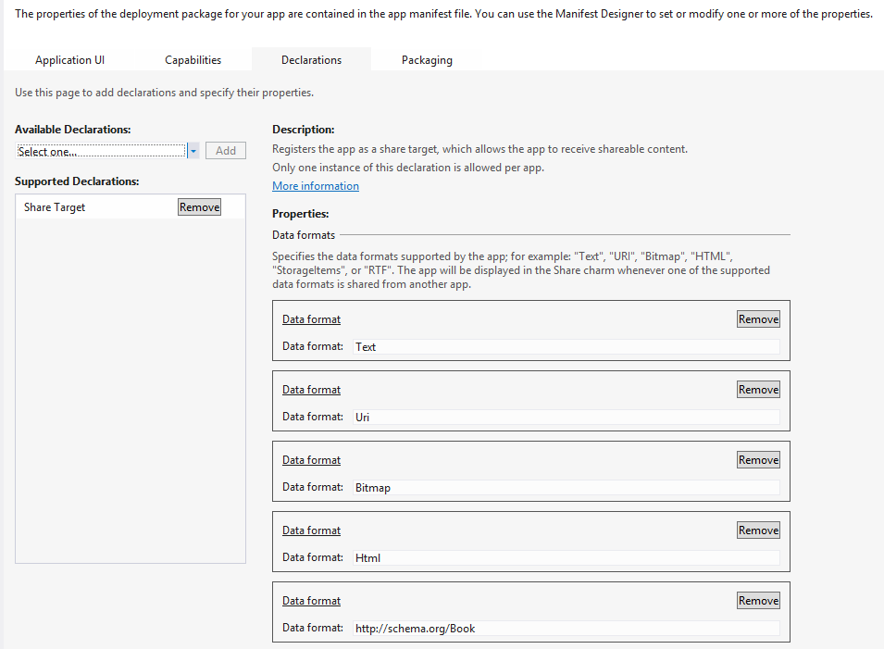
Share Target
Notes:
Demo share from IE
Show target code from F:\Projects\Windows 8 Release Preview Metro style app samples - C#, VB.NET, C++, JavaScript\Sharing content target app sample\C#

Slide 15
Windows 8 Integration Options
Charms
Search
Pickers
File
Contracts
Extension
Share
Contact
Protocol
Settings
Notes:
Summary

Slide 16
Resources
Building Windows Blog
http://blogs.msdn.com/b/b8/
Build Videos
http://www.buildwindows.com/
Windows 8 Samples
http://code.msdn.microsoft.com/windowsapps/
Activation options
http://msdn.microsoft.com/en-us/library/windows/apps/hh464906.aspx#file_activation
Contracts & Micro formats
http://www.schema.org

Slide 17
Questions
>
@JimWooley
http://www.ThinqLinq.com

